Slide 1

Immersed in the sounds of space.
Team Sound Surfers
Eoghan, Dave, Aine, Diarmuid, Fabrizio

Slide 2
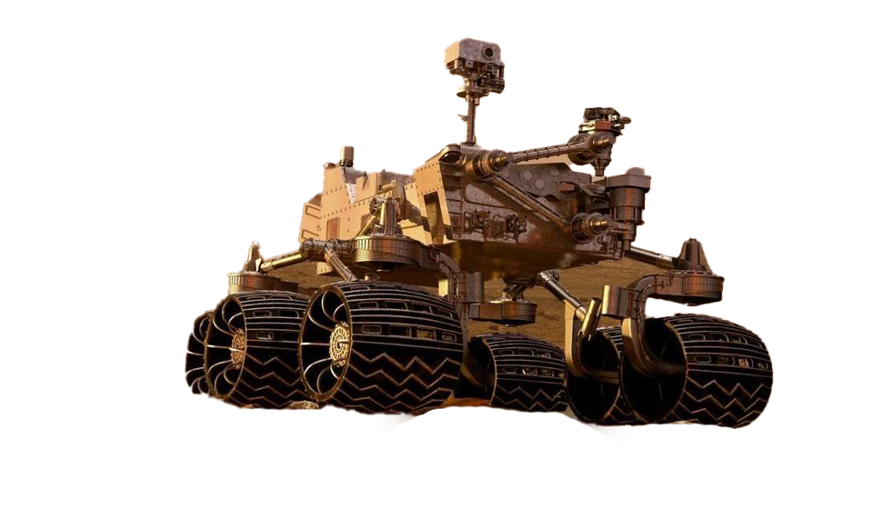
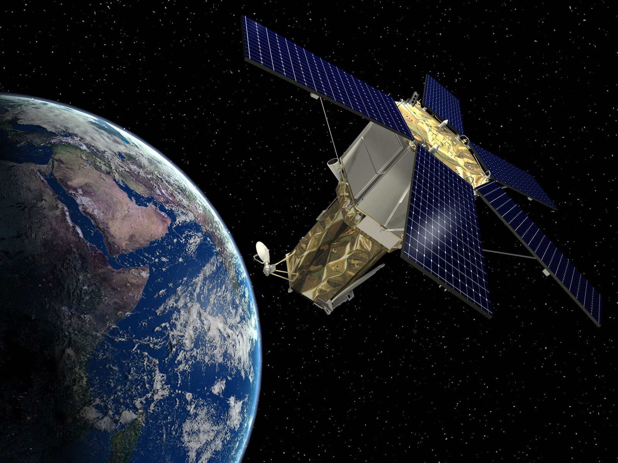
Problem Statement
Large amounts of data

Slide 3

Solution space
Sonification of data
To aid data analysis
Draw attention to areas of interest in the data
Increase public engagement
Increase immersion
Increase interaction

Slide 4
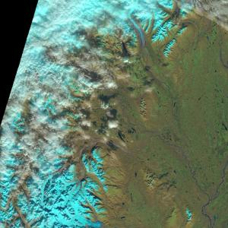
Solution space
Sonification of data
To aid data analysis
Draw attention to areas of interest in the data
Increase public engagement
Increase immersion
Increase interaction

Slide 5
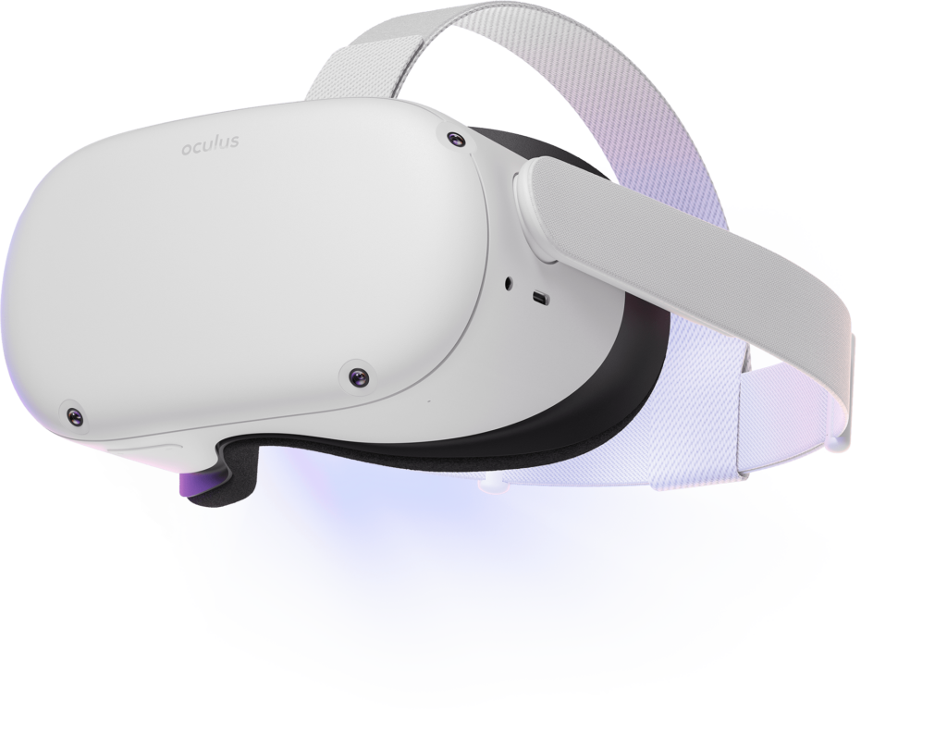
Challenge
Our team will make this data presentation idea
More immersive
By applying it to VR
More interactive
VR fly-through of the data
Head pose driven

Slide 6
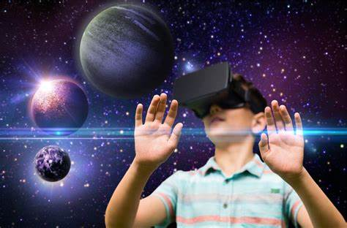
Use cases
This solution has viable benefits for
Improved data analysis
Increased public engagement
Education
Aid to the visually impaired

Slide 7
Demo

Slide 8
Q & A

